Slide 1
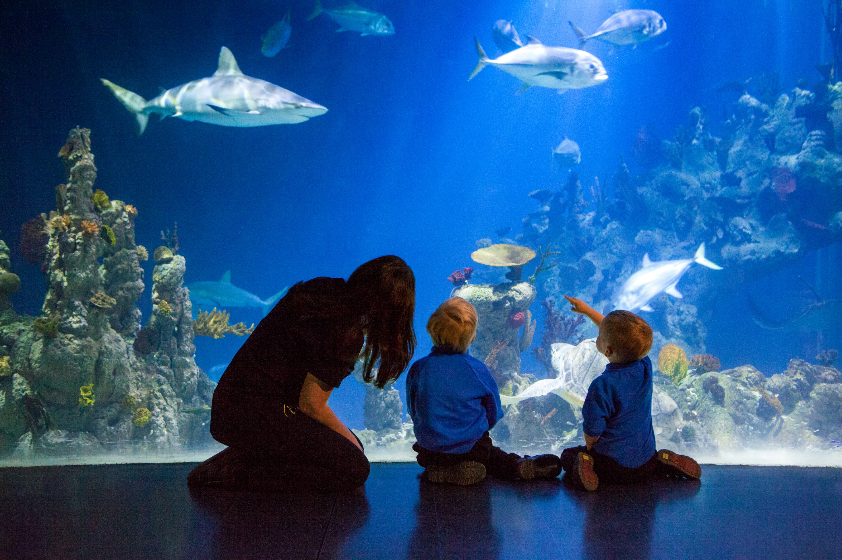
Social Story
^{Preparing for your}
^{School Visit}

Slide 2
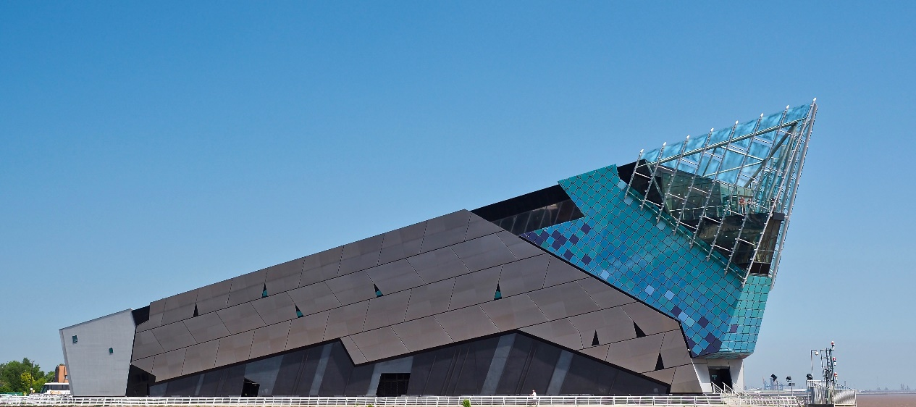
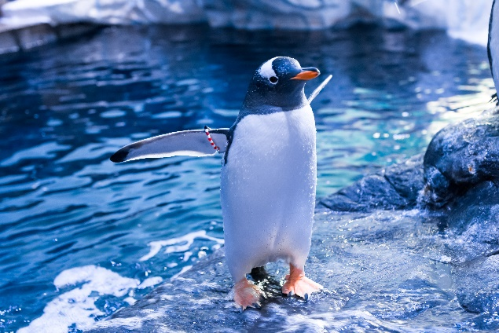
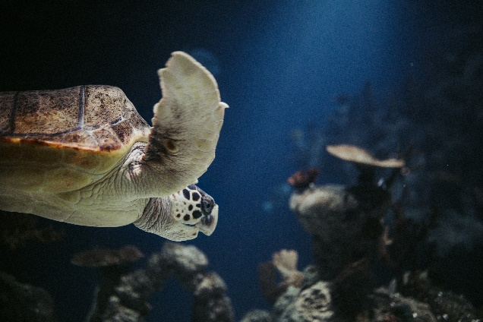
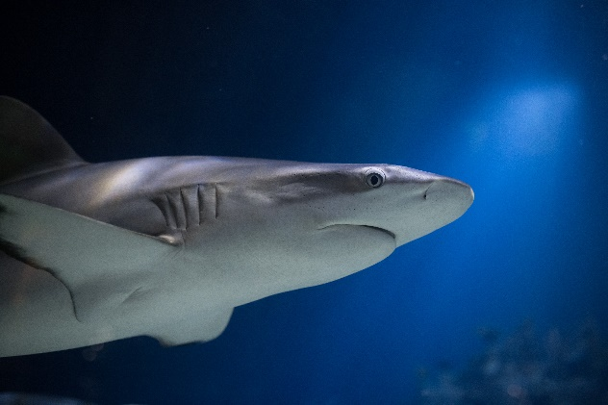
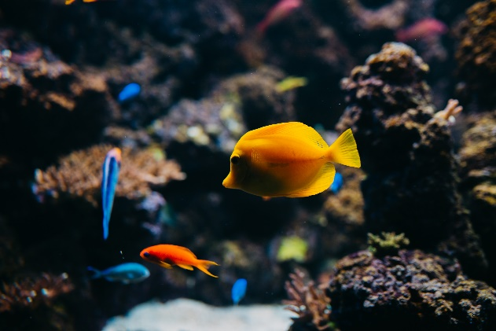
introduction
The Deep is an aquarium in Hull, where you can learn all about the world’s oceans and the creatures that live in them. See amazing animals including sharks, rays, turtles, and a colony of penguins.

Slide 3
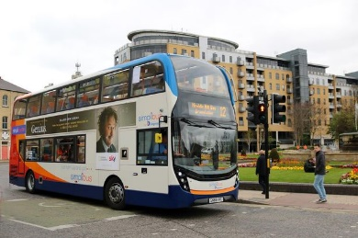
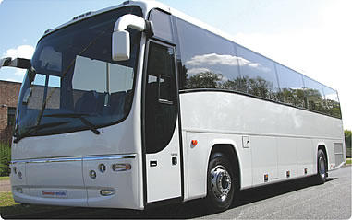
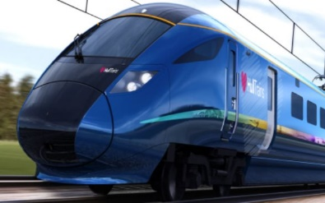
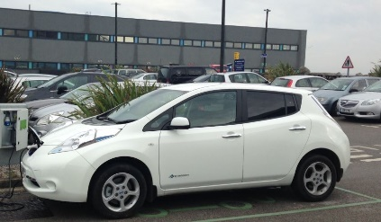
travelling to the deep
We will be visiting The Deep on
We will leave at
We will be travelling to The Deep by
Day of the week__________________
Date____________________________
Month__________________________
Year____________________________
Bus
Coach
Train
Car

Slide 4
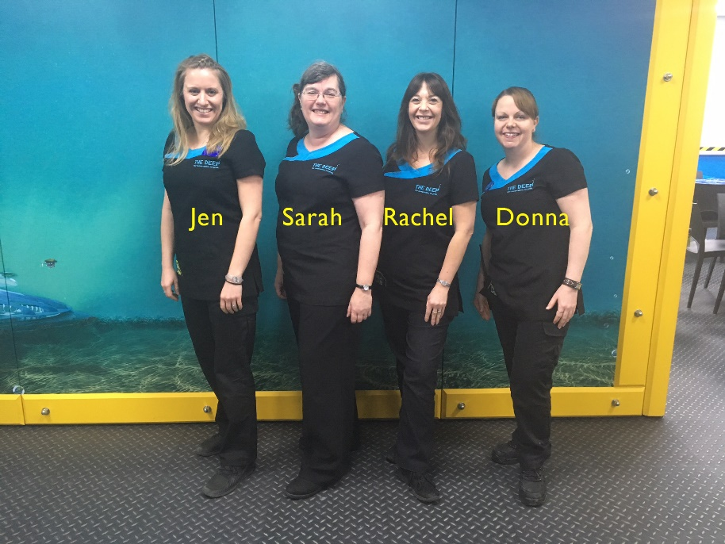
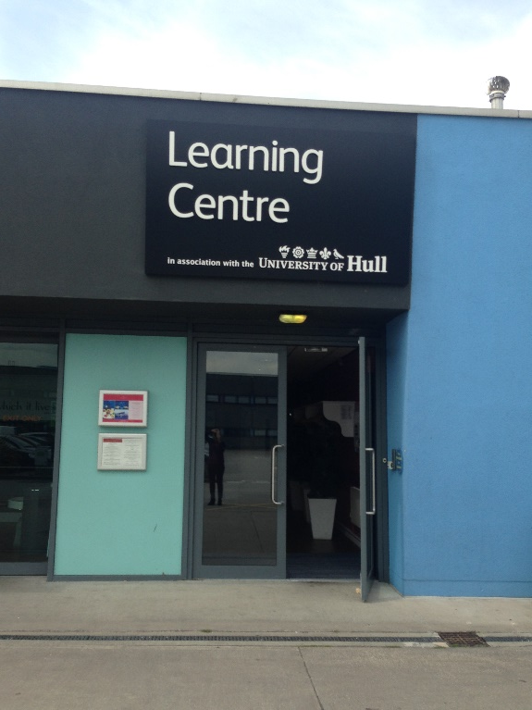
arrival
This is where your coach will drop you off at the start of the day and pick you up to take you home at the end of your visit.
We will greet you when you arrive and give you a timetable for your visit.
If you are having a workshop we will be one of your teachers.

Slide 5
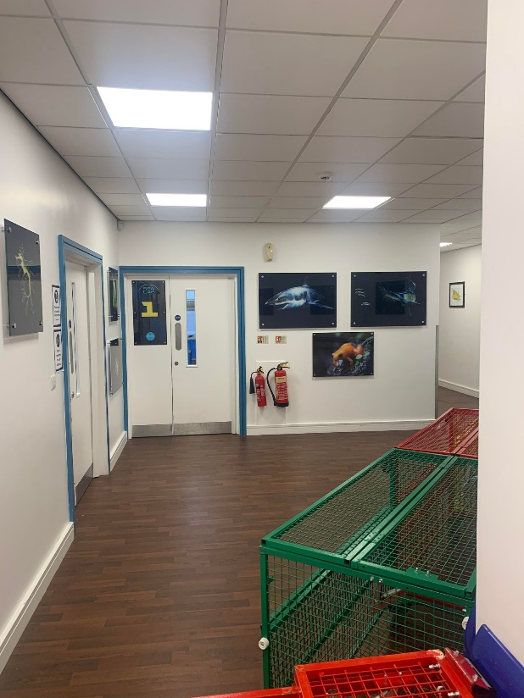
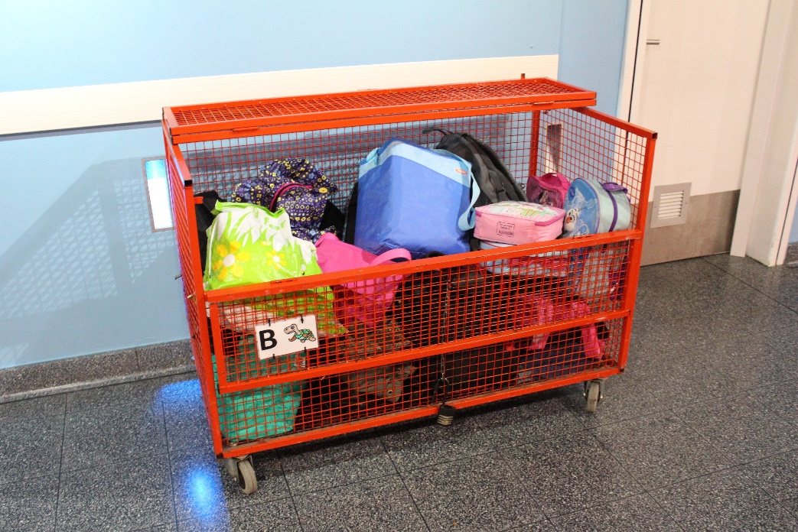
arrival
We will make sure that you have a storage basket to put your coats and lunch in.
This is the corridor where you will find our SeaLabs. You may have to wait here for the workshop to begin.

Slide 6
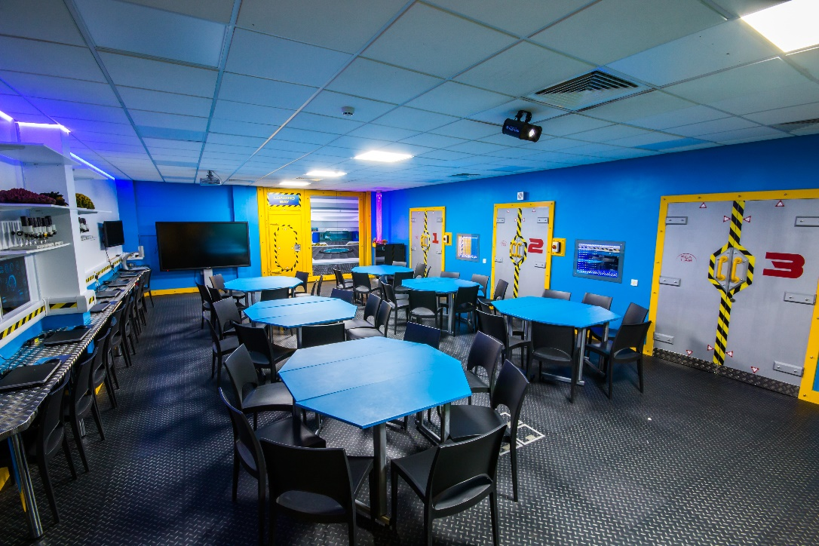
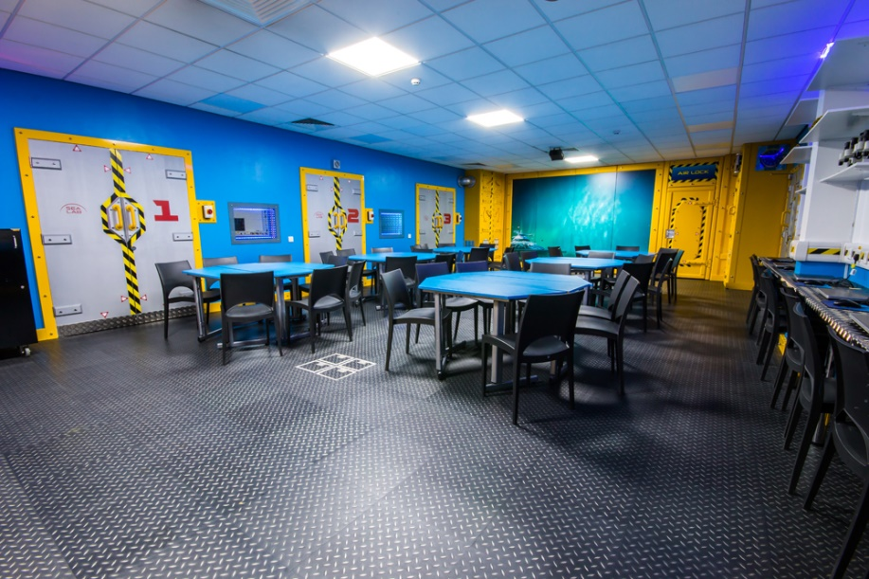
arrival
Workshops take place in our fantastic SeaLabs, with microscopes, infinity mirrors and sensory bubble tubes.

Slide 7
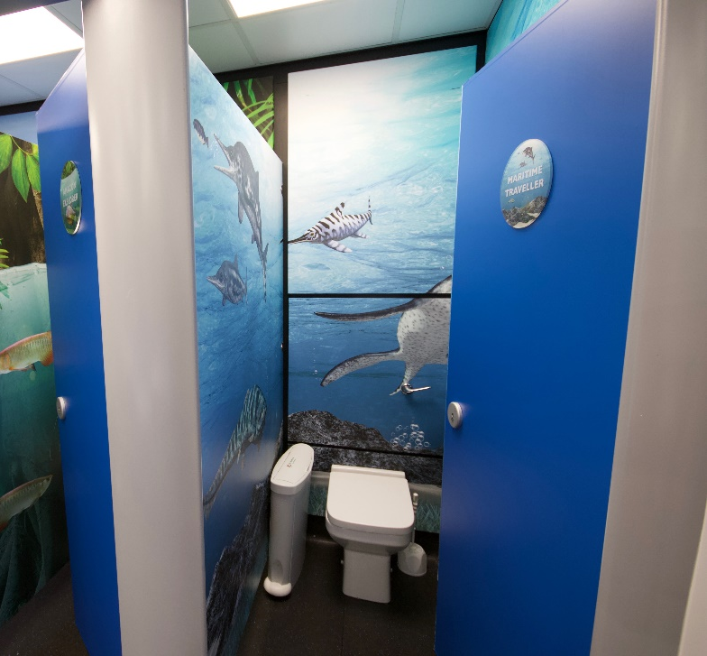
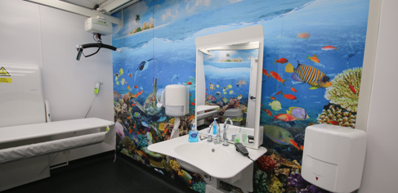
arrival
If at any point you need a toilet break there are male, female and accessible toilets on every floor.
We also have a Changing Places facility on the ground floor (opposite the lifts). This has an adjustable bench, hoist, adjustable basin and mirror, centrally placed toilet and privacy screen.
This facility is accessed with a radar key (you can either use your
own or borrow one from reception). here for the workshop to begin.

Slide 8
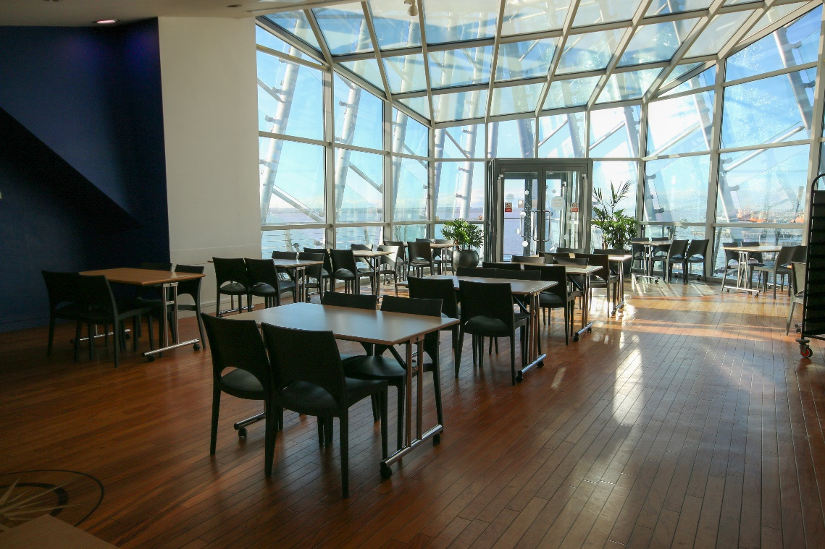
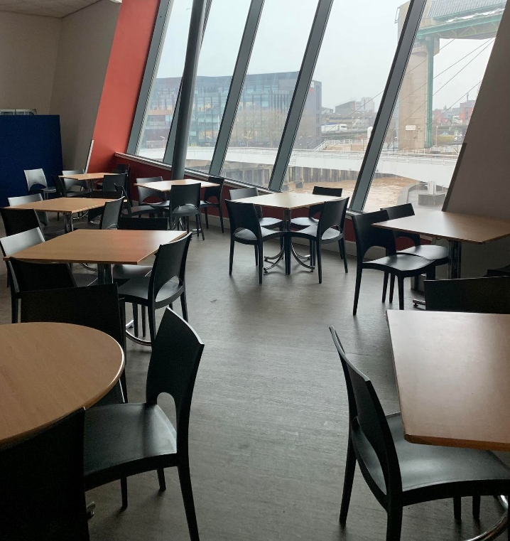
lunch area
We may have lunch in the Observatory or Halfway café. ^{Toilets are available here.}
^{Observatory}
^{Halfway café}

Slide 9
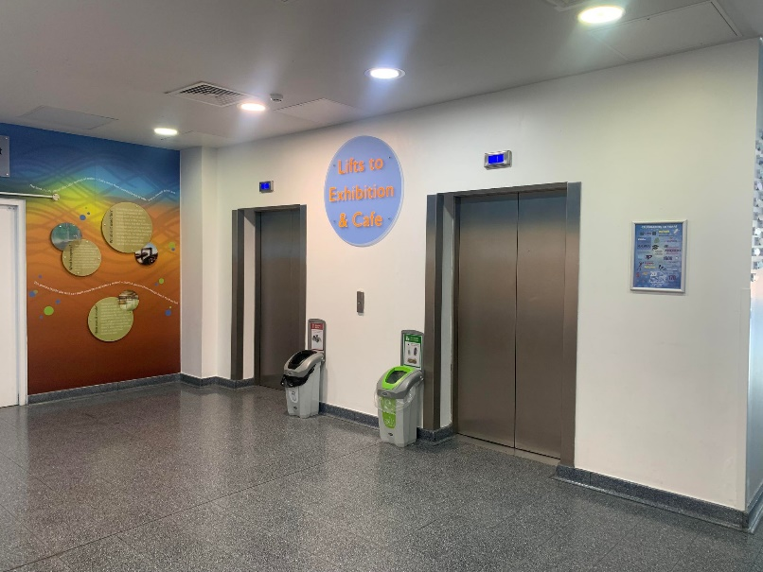
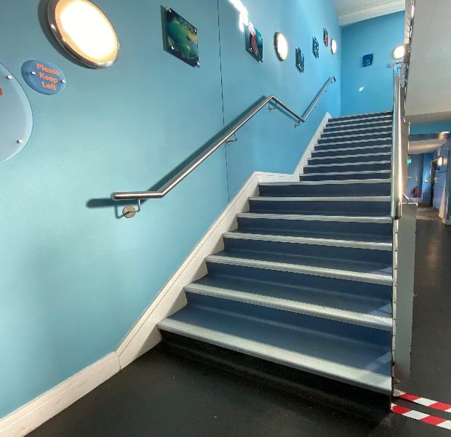
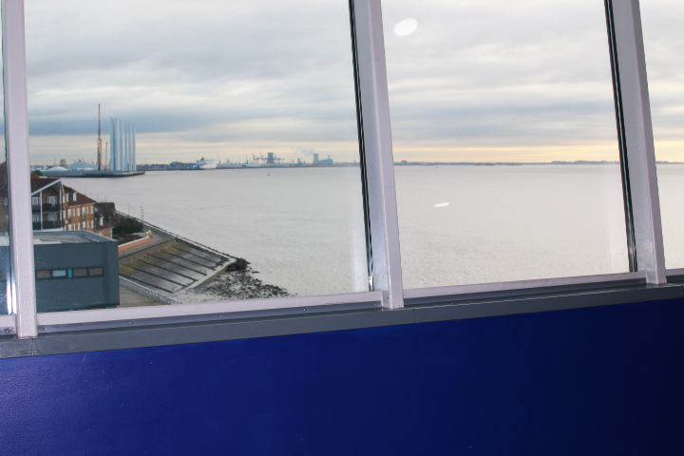
entering the aquarium
These are the lifts you might use to get to the 3rd floor. You may take the stairs if you are with a big group.
There are 81 steps to the 3rd floor.
On leaving the lift, the doors may open on either side.
On one side, you will be able to see the Humber and maybe some ferries at the port out of the big window if it is a nice day.
Stairs this way

Slide 10
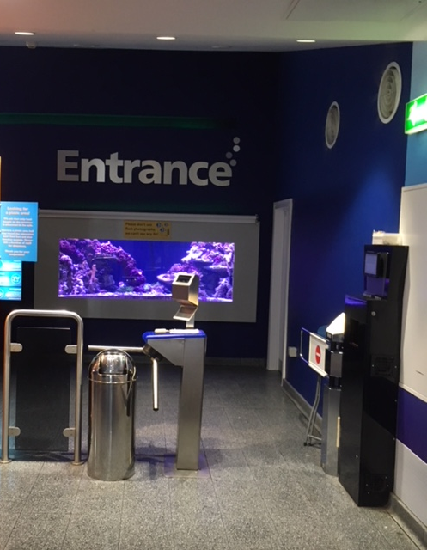
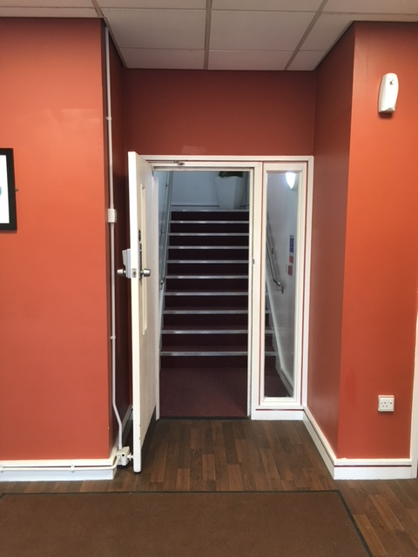
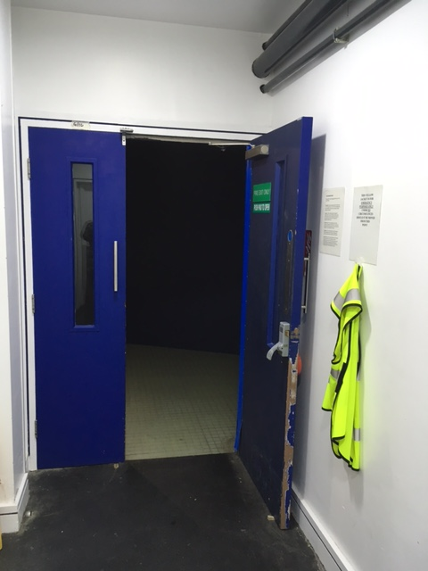
entering the aquarium
You may enter the attraction through the turnstile on the 3rd floor, through Deep Blue One, or up the stairs which lead to the Halfway café.
^{Turnstile entrance}
^{Halfway café entrance}
^{Deep Blue One entrance}

Slide 11
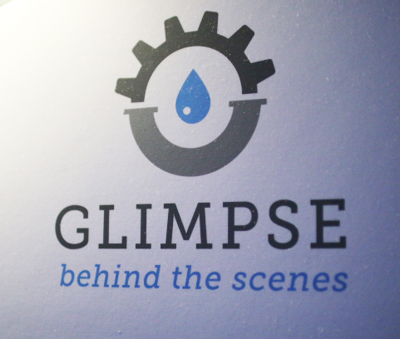
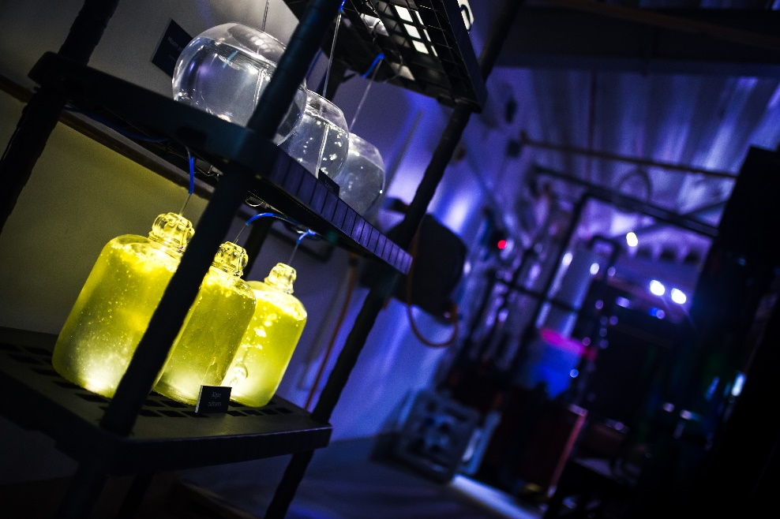
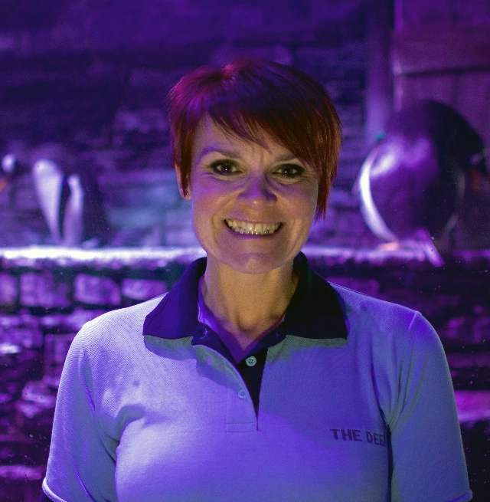
good to know before you start
Look out for The Deep Crew around the building. They are there to help, so feel free to ask those questions!
You may see some areas called ‘Glimpse’ as you go around, giving you the opportunity to view 8 working areas ‘behind the scenes’.

Slide 12
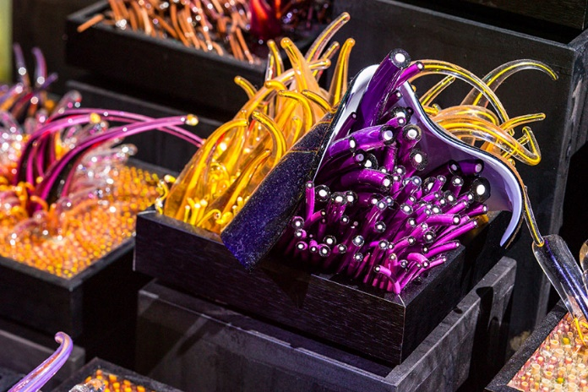
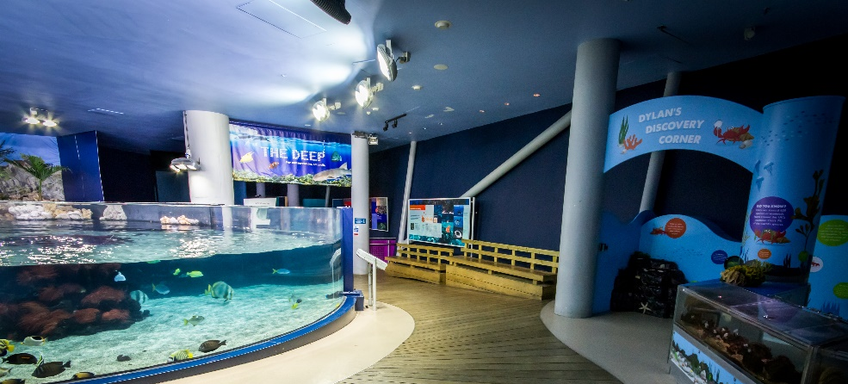
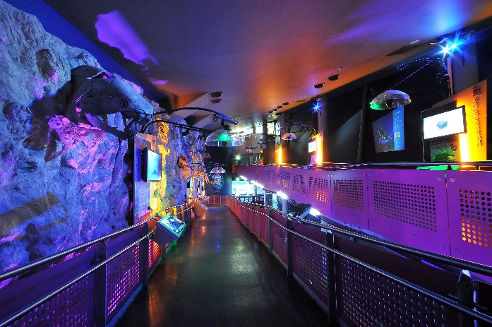
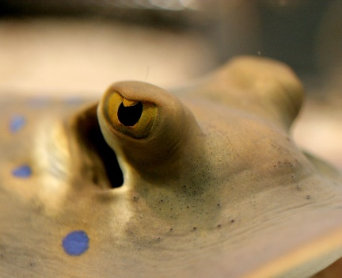
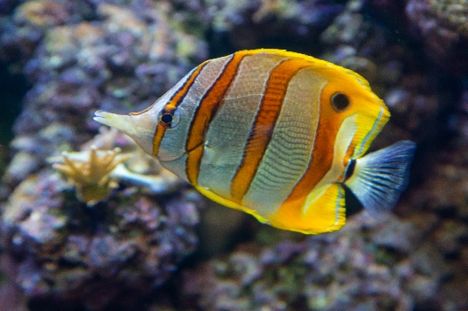
in the aquarium
At the start of your journey, you will go through a dark room with a colourful glass sculpture. It can be noisy here too. If you would like to avoid this area just ask the guide on the entrance turnstile!
^{The Lagoon of Light is next.}
It is home to lots of tropical fish, including the ones you can see in these pictures. You will also see brightly coloured corals and large mangrove trees.
^{As you walk down the}
^{timeline, you will find}
^{interesting facts about}
^{the creation of the}
oceans, as well as seeing fossils and starfish.

Slide 13
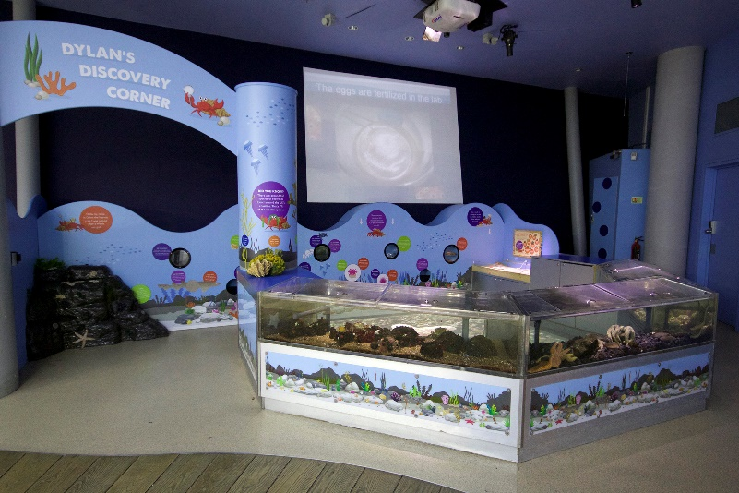
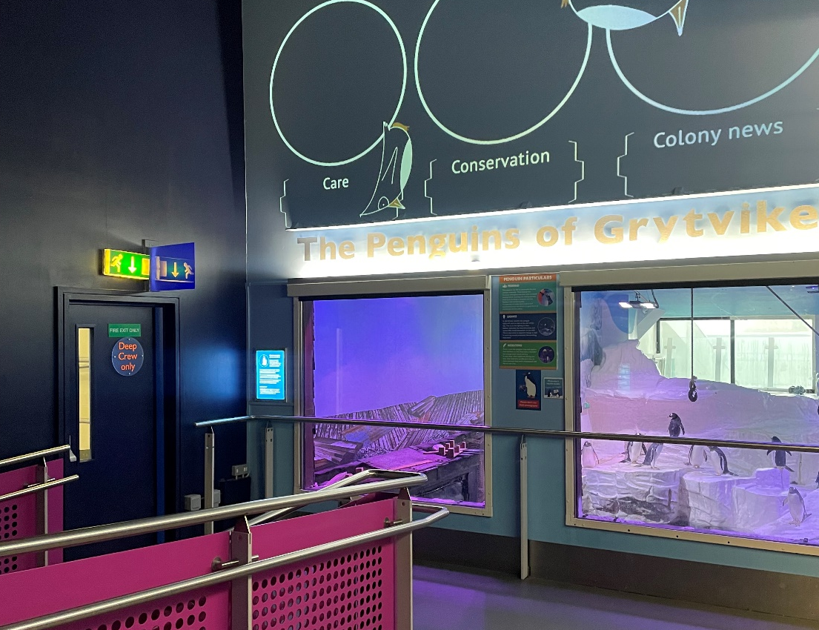
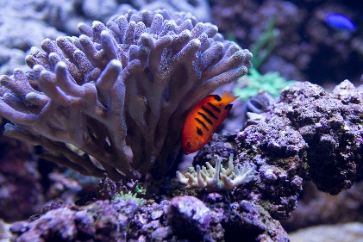
in the aquarium
Look out for your first glimpse of our colony of Gentoo penguins as you go down the ramp.
At Dylan’s Discovery Corner there are sensory objects and an interactive floor.
Next you will see the Living Coral display.

Slide 14
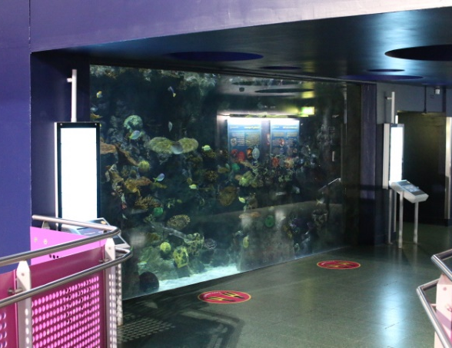
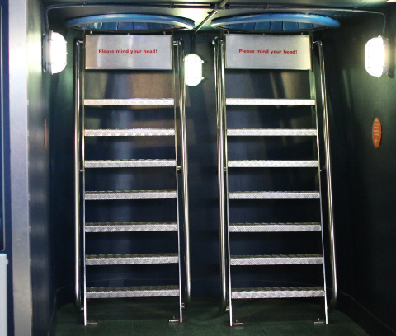
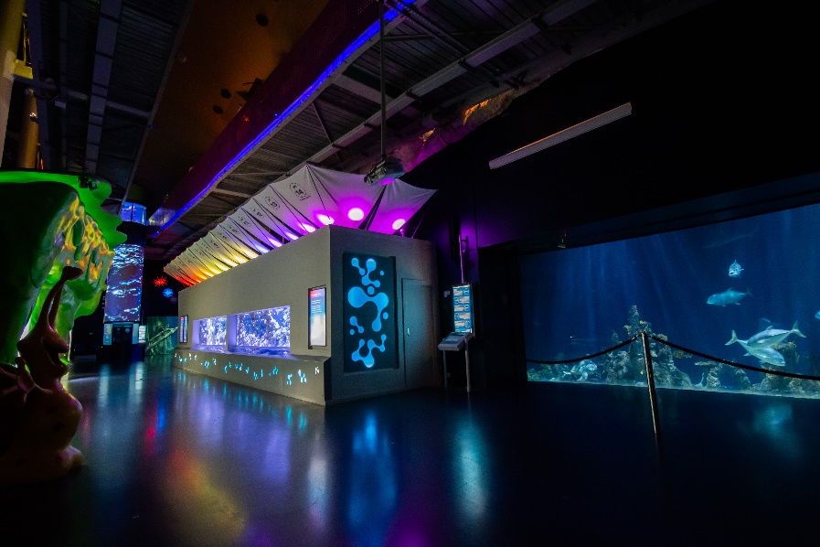
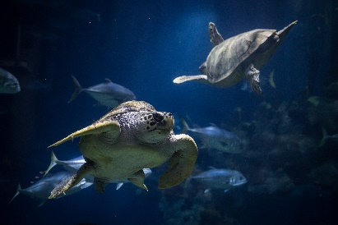
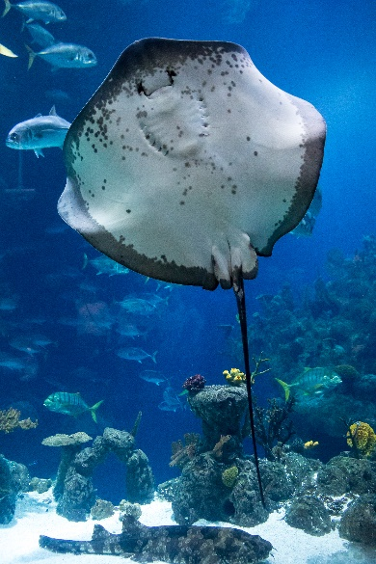
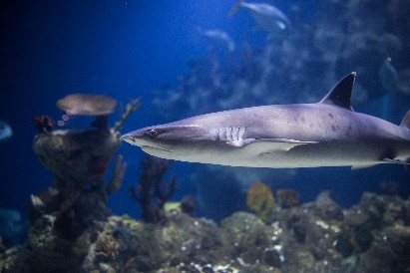
in the aquarium
Next you can see the deep side of the lagoon.
The overhead viewing bubbles have steps that can be climbed so you can look up into our lagoon.
As you enter Endless Ocean, you will see amazing animals including sharks, rays and sawfish. You may also catch a glimpse of our turtles here.

Slide 15
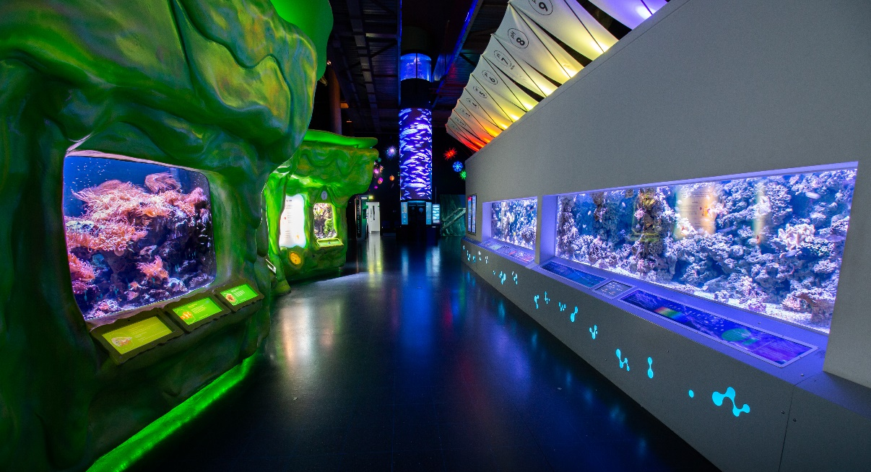
in the aquarium
You will find the colourfully lit Slime and Changing Seas Exhibit next to Endless Oceans.
Learn about climate change and how ocean acidification is affecting our oceans and the animals that live there, by reading the information available on the 3 screens on the display and moving projection above.
Next up is the Amazon Flooded Forest, home to species
from the Amazon River including catfish and pacu.

Slide 16
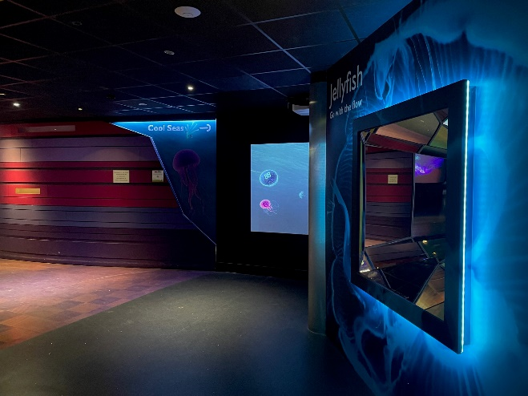
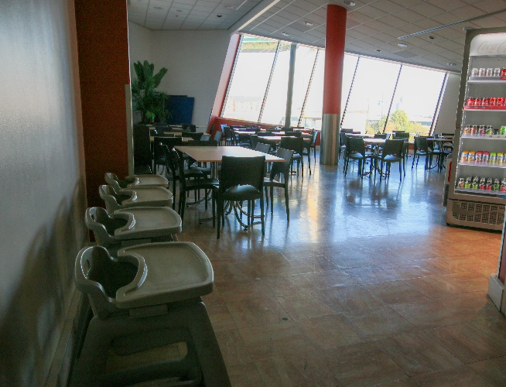
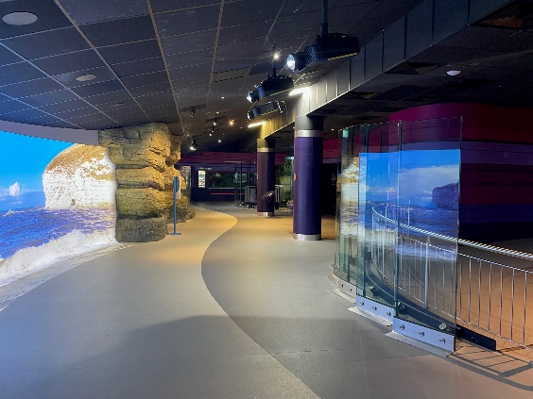
in the aquarium
Cool Seas is quite dark but very tranquil.
Visit our ambient jellyfish room to take a closer look at the amazing species that live here and learn about their lifecycle.
Next you will find the entrance into the Cool Seas exhibit.
Toilet facilities are available in this area and the Halfway Cafe here is open on weekends and in school holidays until 4pm.
Make your way further round to watch waves crash into our rockpool, awaken your senses as you are transported to our virtual local coastline, create land in our interactive sandpit and view many weird and wonderful creatures who live in the deepest oceans.

Slide 17
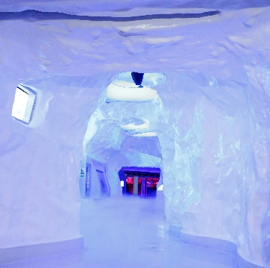
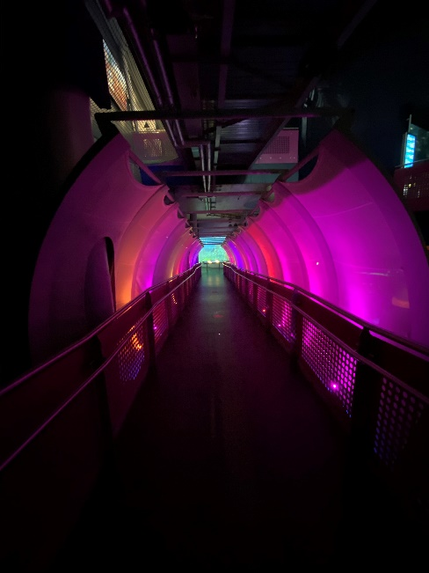
in the aquarium
Next you can walk through the chilly Kingdom of Ice and learn about the polar region. You can touch the real ice walls on your way!
Follow the colourful rainbow walk way down to Digi:Sea, an interactive station where you can colour your own sea creature and upload it to the virtual ocean!
At the bottom of the Kingdom of Ice is another penguin viewing window. Look out for the penguins on the ice, pebbled beach or swimming.
Next, turn around and head down the stairs or use the accessible lift in the corner.

Slide 18
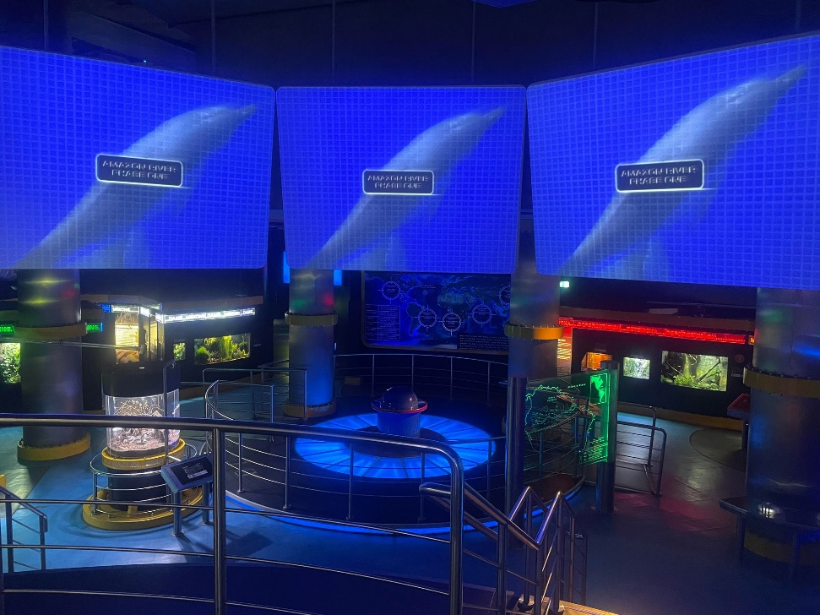
in the aquarium
When you arrive at Deep Blue One make sure you don’t miss seeing our smaller animal displays around hidden corners.
The room is quite dark with lots of bright lights and loud noises.
You are getting close to the end of your visit now. Make your way through the stunning viewing tunnel and see the schooling fish, amazing sharks and rays swimming all around. You may have to wait a short while to enter this space.

Slide 19
in the aquarium
At the end of the tunnel you can turn left for Glimpse to learn about the engineering work that keep the aquariums running, or you can ^{turn right towards the lift} ^{and stairs to exit.}
The last stage of your journey is the bubble lift. Take a ride through the 10m deep Endless Ocean exhibit. During off peak and term time there may be a short pause for you to admire the view, including a sneak peek behind the scenes! If you prefer you can use the scenic stairs instead. There are 75 steps to the top with some wonderful viewing areas along the way.

Slide 20
before you leave
Finally, take the lift back down to the ground floor to exit The Deep. Here you will find the ‘Deepartment’ store with
a range of souvenirs and gifts.
As you exit the shop, look out for the river turtles.
^{‘Sea’ you soon!}

